Slide 1
Analyzing Sales Funnel for a Student Hostel Accomodation Chain
Ashish Kumar
Ashishkumar.hh2000@gmail.com

Slide 2
Situation
Strent AH Pvt Limited (SAPL) has recently started a chain of student hostels in major cities across India. They provide flexible room rentals to university students and exam aspirants through their app and web applications. These accommodations can be booked for durations of 3, 6, 9, and 11 months
During the admission season of May and June, SAPL experienced an unexpected surge in web page visits and mobile app usage for their platform called Rento. It was noticed that leads were generated from various landing pages, social media marketing channels, and organic sources. However, the actual number of students who successfully joined SAPL was relatively low ( ~ 13 % ) compared to the number of leads generated.
SAPL aimed to investigate the reasons behind the significantly low conversion rate of ~ 13 %. They sought to analyze various stages of student acquisition to gain a deeper understanding of the factors contributing to the substantial drop.
Ashishkumar.hh2000@gmail.com

Slide 3
Deep Dive
The Sales & Operations Director conducted an initial team meeting to explore different hypotheses related to the low conversion rate.
→During the meeting, two key areas of concern were identified: a lower percentage of calls made by the customer care team and a lower percentage of property visits scheduled by leads.
After discussing with the team, you have been assigned the task of diving deeper into the assumption that the low conversion rate is primarily attributed to the lower percentage of calls made by the customer care team.
It was observed that leads were not being contacted within the specified time frame after their creation, resulting in the company's inability to identify and capitalize on hot leads, thereby missing out on significant business opportunities.
Ashishkumar.hh2000@g,ail.com
Ashishkumar.hh2000@gmail.com

Slide 4
Early Win Challenge
"The total number of leads generated is 500 in week 1 of March. out of the total leads who created a login and verified their mobile numbers: 350. And leads who got categorized as hot leads by the customer care team is only 200; all these 200 leads, got their visits scheduled only 150. leads who finalized the hostel and entered into an agreement and were onboarded is 100."
Ashishkumar.hh2000@gmail.com

Slide 5
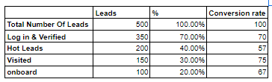
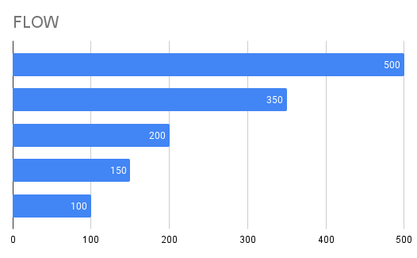
Solution
Ashishkumar.hh2000@gmail.com

Slide 6
Process View
pre verified
Verified
Visited
Agreement
connected
onboarded
This stage represents the initial phase of the funnel, where leads are in the process of being verified for eligibility and suitability.
After the pre-verification stage, leads move to the verified stage, indicating that they have met the necessary criteria and have been confirmed as qualified prospects.
In this stage, the verified leads have progressed further and have visited the designated location or platform for further engagement and interaction.
Once the leads have visited and expressed interest, the agreement stage is reached, where negotiations and discussions take place to establish mutual terms and conditions.
After reaching an agreement, the leads move to the connected stage, where the necessary connections and arrangements are made to facilitate the intended purpose or service.
The final stage of the funnel is the onboarding stage, where the leads are officially welcomed and integrated into the system, becoming active participants or users of the offered service.
Ashishkumar.hh2000@gmail.com

Slide 7
Sales Funnel
OVERALL FUNNEL STAGES
 | pre verified | Verifed | Visited | Agreement | connected | onboarded | Total
Delhi | 698 | 366 | 321 | 232 | 160 | 44 | 1821
Noida | 165 | 91 | 74 | 28 | 39 | 2 | 399
Bangalore | 449 | 240 | 220 | 158 | 101 | 27 | 1195
Gurugram | 683 | 361 | 280 | 174 | 145 | 30 | 1673
Mumbai | 276 | 147 | 126 | 90 | 63 | 16 | 718
Pune | 332 | 164 | 114 | 59 | 71 | 12 | 752
Hyderabad | 210 | 123 | 117 | 76 | 51 | 11 | 588
Ahmedabad | 107 | 54 | 31 | 13 | 24 | 7 | 236
Chandigarh | 52 | 25 | 17 | 8 | 12 | 0 | 114
Kolkata | 153 | 88 | 63 | 47 | 34 | 10 | 395
Blank | 359 | 198 | 155 | 84 | 83 | 9 | 888
 | 3484 | 1857 | 1518 | 969 | 783 | 168 | 8779
“Delhi” has the highest values for “pre verified” (698), “Verified” (366), “Visited” (321), and 4 others.
Ashishkumar.hh2000@gmail.com

Slide 8
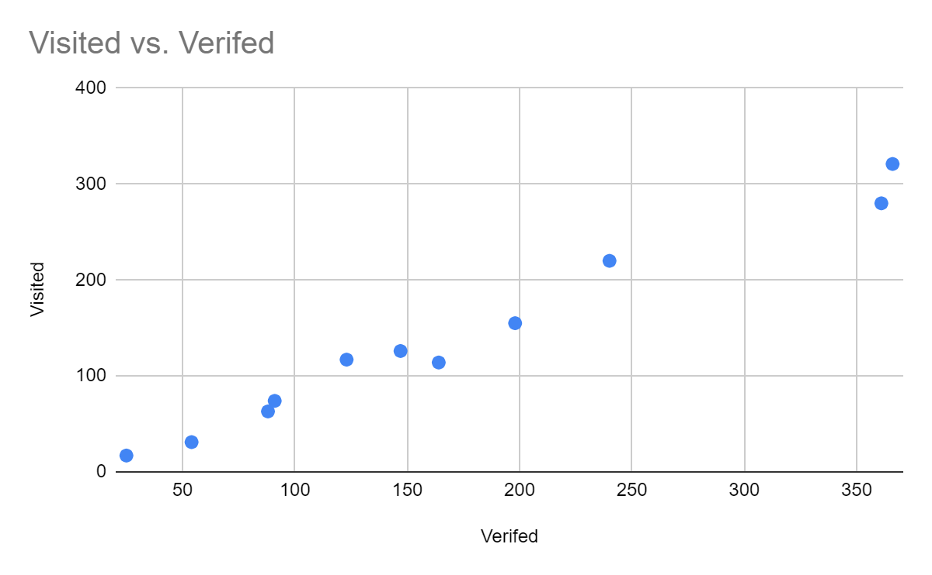
Analysis
For every increase of 100 in “Verified”, “Visited” increases by about 85.5.
Ashishkumar.hh2000@gmail.com

Slide 9
Analysis
% OF STAGES LEADS {(STAGE LEAD/TOTAL LEAD)*100}
 | pre verified | Verifed | Visited | Agreement | connected | onboarded | Average
Delhi | 38 | 20 | 18 | 13 | 9 | 2 | 17
Noida | 41 | 23 | 19 | 7 | 10 | 1 | 17
Bangalore | 38 | 20 | 18 | 13 | 8 | 2 | 17
Gurugram | 41 | 22 | 17 | 10 | 9 | 2 | 17
Mumbai | 38 | 20 | 18 | 13 | 9 | 2 | 17
Pune | 44 | 22 | 15 | 8 | 9 | 2 | 17
Hyderabad | 36 | 21 | 20 | 13 | 9 | 2 | 17
Ahmedabad | 45 | 23 | 13 | 6 | 10 | 3 | 17
Chandigarh | 46 | 22 | 15 | 7 | 11 | 0 | 17
Kolkata | 39 | 22 | 16 | 12 | 9 | 3 | 17
Blank | 40 | 22 | 17 | 9 | 9 | 1 | 17
“Chandigarh” has the highest values for “pre verified” (46) and “connected” (11) and the lowest value for “onboarded” (0).
The biggest difference between “pre verified” and “onboarded” is 46 at “8”.
Ashishkumar.hh2000@gmail.com

Slide 10
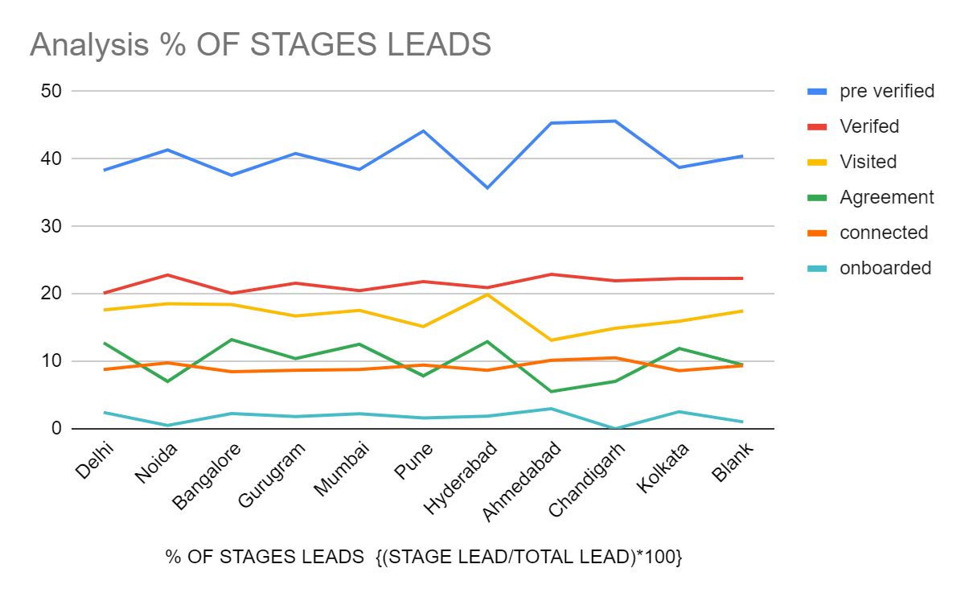
Ashishkumar.hh2000@gmail.com

Slide 11
Ashishkumar.hh2000@gmail.com
Analysis
CONVERSATION RATE
 | pre verified | Verifed | Visited | Agreement | connected | onboarded | Average
Delhi | 38 | 52 | 88 | 72 | 69 | 28 | 58
Noida | 41 | 55 | 81 | 38 | 139 | 5 | 60
Bangalore | 38 | 53 | 92 | 72 | 64 | 27 | 58
Gurugram | 41 | 53 | 78 | 62 | 83 | 21 | 56
Mumbai | 38 | 53 | 86 | 71 | 70 | 25 | 57
Pune | 44 | 49 | 70 | 52 | 120 | 17 | 59
Hyderabad | 36 | 59 | 95 | 65 | 67 | 22 | 57
Ahmedabad | 45 | 50 | 57 | 42 | 185 | 29 | 68
Chandigarh | 46 | 48 | 68 | 47 | 150 | 0 | 60
Kolkata | 39 | 58 | 72 | 75 | 72 | 29 | 57
Blank | 40 | 55 | 78 | 54 | 99 | 11 | 56
“Ahmedabad” has the highest values for “connected” (185) and “Average” (68) and the lowest value for “Visited” (57).
“Visited” has the highest values from the beginning until “Chandigarh”.
Overall Conversion rate | 17%

Slide 12
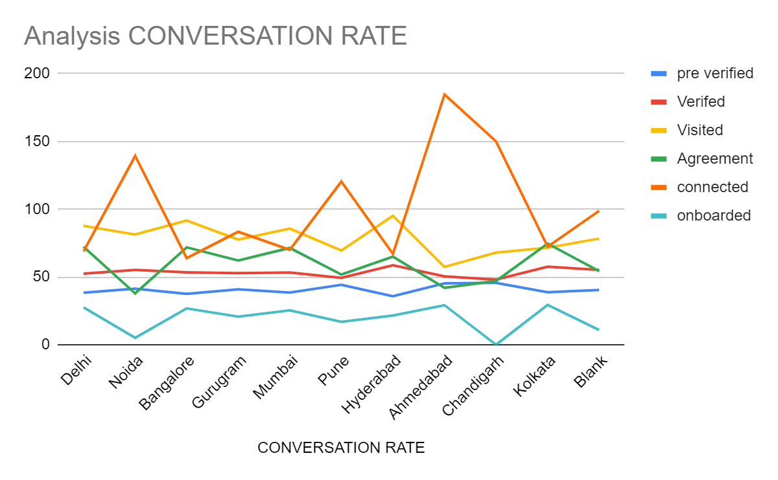
Ashishkumar.hh2000@gmail.com

Slide 13
Analysis Insight From Conversion Table
On The Basis Of every stage of funnel to get clear understanding
CONVERSATION RATE
 | pre verified | Verifed | Visited | Agreement | connected | onboarded | Average
Delhi | 38 | 52 | 88 | 72 | 69 | 28 | 58
Noida | 41 | 55 | 81 | 38 | 139 | 5 | 60
Bangalore | 38 | 53 | 92 | 72 | 64 | 27 | 58
Gurugram | 41 | 53 | 78 | 62 | 83 | 21 | 56
Mumbai | 38 | 53 | 86 | 71 | 70 | 25 | 57
Pune | 44 | 49 | 70 | 52 | 120 | 17 | 59
Hyderabad | 36 | 59 | 95 | 65 | 67 | 22 | 57
Ahmedabad | 45 | 50 | 57 | 42 | 185 | 29 | 68
Chandigarh | 46 | 48 | 68 | 47 | 150 | 0 | 60
Kolkata | 39 | 58 | 72 | 75 | 72 | 29 | 57
Blank | 40 | 55 | 78 | 54 | 99 | 11 | 56
Ashishkumar.hh2000@gmail.com

Slide 14
Pre-Verified: The conversion rates from the "Pre-Verified" stage to the "Verified" stage are as follows:
Insights: The conversion rates from the "Pre-Verified" stage to the "Verified" stage vary across different cities, ranging from 35.71% to 45.61%. This indicates that the verification process is relatively successful in converting leads to verified prospects. However, there is still room for improvement in some cities, such as Hyderabad, where the conversion rate is lower.
Ashishkumar.hh2000@gmail.com

Slide 15
Verified: The conversion rates from the "Verified" stage to the "Visited" stage are as follows:
Insights: The conversion rates from the "Verified" stage to the "Visited" stage are relatively consistent across cities, ranging from 20.08% to 22.88%. This suggests that the verification process is effective in driving prospects to visit the hostels.
Ashishkumar.hh2000@gmail.com

Slide 16
Visited: The conversion rates from the "Visited" stage to the "Agreement" stage are as follows
Insights: The conversion rates from the "Visited" stage to the "Agreement" stage vary across cities, ranging from 13.14% to 19.90%. This indicates that there are differences in the effectiveness of converting hostel visits to agreement signings. Cities like Hyderabad have a higher conversion rate, while Ahmedabad and Chandigarh have lower conversion rates.
Ashishkumar.hh2000@gmail.com

Slide 17
Agreement: The conversion rates from the "Agreement" stage to the "Connected" stage are as follows:
Insights: The conversion rates from the "Agreement" stage to the "Connected" stage show variations, ranging from 5.51% to 13.22%. This suggests that there may be challenges in the process of connecting the signed agreements with the actual accommodation. Cities like Bangalore and Hyderabad have higher conversion rates, while Ahmedabad and Pune have lower conversion rates.
Ashishkumar.hh2000@gmail.com

Slide 18
Connected: The conversion rates from the "Connected" stage to the "Onboarded" stage are as follows:
Insights: The conversion rates from the "Connected" stage to the "Onboarded" stage are relatively consistent across cities, ranging from 8.45% to 10.53%. This indicates a successful process of onboarding once the connection is established.
Ashishkumar.hh2000@gmail.com

Slide 19
Onboarded: The conversion rates from the "Pre-verified" stage to the "Onboarded" stage are as follows:
Insights: The "Onboarded" stage represents the number of individuals who have successfully completed the entire journey, from initial lead generation to formal onboarding. In this dataset, a total of 168 individuals have reached this final stage across different cities. This could be seen as a measure of successful conversions. To improve this metric, it's crucial to analyze the stages where the drop-offs are occurring and focus on optimizing those areas of the funnel. Additionally, understanding the specific factors that contributed to successful onboarding can inform strategies for replicating this success in other locations or markets.
Ashishkumar.hh2000@gmail.com

Slide 20
Overall:
Overall, it's important to note that the average conversion rates for each stage are consistent at 16.67%, which suggests that the overall performance of the sales funnel is balanced. However, there are specific areas where improvements can be made. Focus on enhancing the conversion rates in stages where the performance is relatively low, such as the "Visited" to "Agreement" stage in cities like Ahmedabad and Chandigarh or the "Agreement" to "Connected" stage in cities like Ahmedabad and Pune.
Ashishkumar.hh2000@gmail.com

Slide 21
Recommendations and Strategies
Based on the analysis of the sales funnel for your student hostel accommodation chain, here are some recommendations and strategies to increase conversion rates at each stage and improve overall performance:
Ashishkumar.hh2000@gmail.com

Slide 22
Pre-Verified to Verified:
Streamline the pre-verification process to ensure efficiency and promptness.
Implement clear and concise communication to convey the benefits and value of becoming a verified prospect.
Provide incentives or exclusive offers for prospects who complete the verification process promptly.
Ashishkumar.hh2000@gmail.com

Slide 23
Verified to Visited:
Enhance the communication and follow-up with verified prospects, emphasizing the unique features and benefits of your hostels.
Offer personalized virtual or physical tours to give prospects a better understanding and experience of the accommodations.
Provide testimonials or reviews from previous residents to build trust and credibility.
Ashishkumar.hh2000@gmail.com

Slide 24
Visited to Agreement:
Improve the hostel visiting experience by ensuring cleanliness, comfort, and a welcoming atmosphere.
Offer competitive pricing and flexible agreement terms to attract prospects.
Provide transparent and comprehensive information about the agreement process, including any additional benefits or services.
Ashishkumar.hh2000@gmail.com

Slide 25
Agreement to Connected:
Establish effective and streamlined processes for transitioning from agreement signing to connecting the prospect with the designated accommodation.
Enhance communication and coordination between your team and the prospect to ensure a smooth transition.
Address any concerns or obstacles promptly to prevent potential drop-offs during this stage.
Ashishkumar.hh2000@gmail.com

Slide 26
Connected to Onboarded:
Provide exceptional customer service and support during the onboarding process, addressing any queries or issues promptly.
Offer assistance with moving logistics or provide resources and recommendations for a seamless transition.
Create a sense of community by organizing orientation events or connecting new residents with existing ones.
Ashishkumar.hh2000@gmail.com

Slide 27
Overall Strategies:
Implement lead nurturing campaigns to maintain engagement and interest throughout the entire funnel.
Utilize digital marketing channels, such as social media and targeted online advertising, to reach a wider audience and generate leads.
Leverage data analytics to identify trends, patterns, and potential bottlenecks in the sales funnel, allowing for continuous optimization and improvement.
Gather feedback from prospects and residents to identify areas for improvement and address any pain points or concerns.
Foster positive relationships with educational institutions or student organizations to increase brand awareness and referrals.
By implementing these recommendations and strategies, you can enhance the performance of your sales funnel, increase conversion rates at each stage, and ultimately improve the overall success of your student hostel accommodation chain
Ashishkumar.hh2000@gmail.com

Slide 28
THANK YOU!
Ashishkumar.hh2000@gmail.com

